Slide 1
Sales Performance Analysis

Slide 2
Introduction
This project analysis sales data across regions, categories, and sales reps to extract insights.

Slide 3
Problem Statement
Lack of structured analysis for sales performance, profit trends, and customer behavior.

Slide 4
Objectives
- Clean dataset
- Perform sales and profit analysis
- Create pivot tables & charts
- Provide insights for decision-making

Slide 5
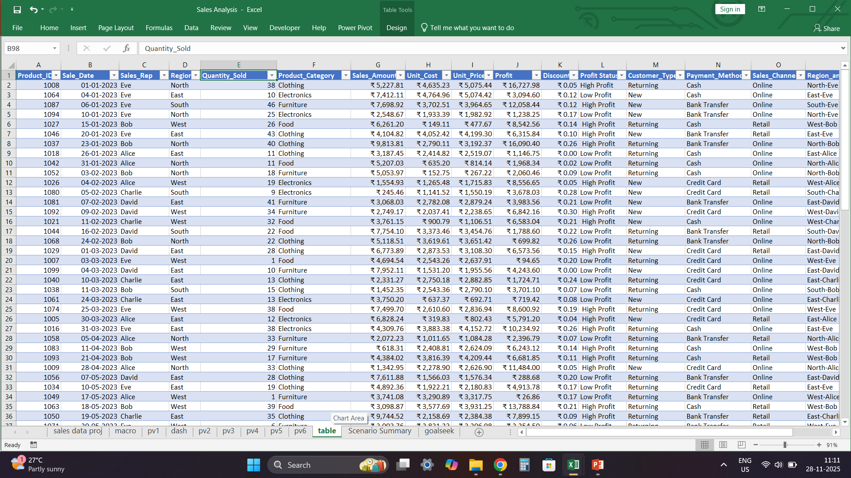
Dataset Description
Contains Product ID, Sales Date, Sales Rep, Region, Quantity, Category, Amount, Cost, Price, Profit, Discount, Customer Type, Payment Method, Channel.

Slide 6
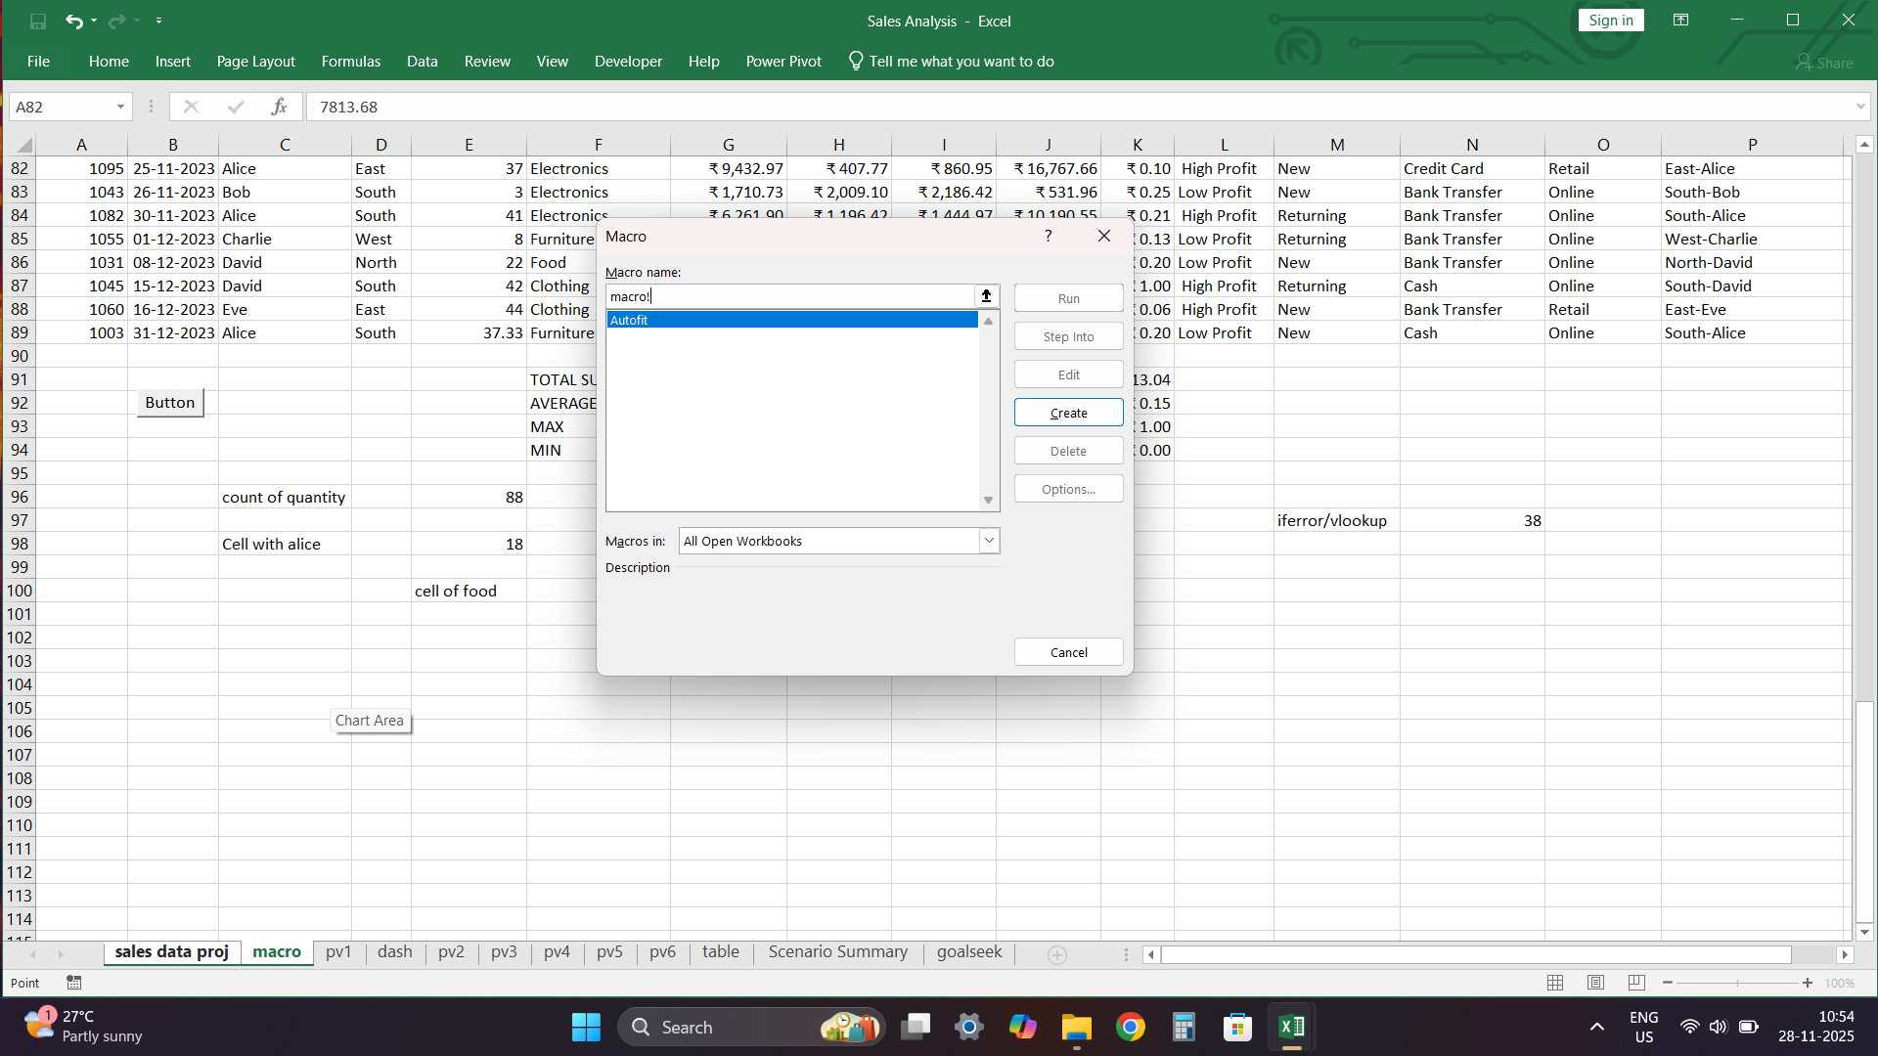
Data Cleaning Steps
- Removed symbols
- Converted numeric fields
- Standardized regions
- Removed duplicates
- Formatted dates

Slide 7
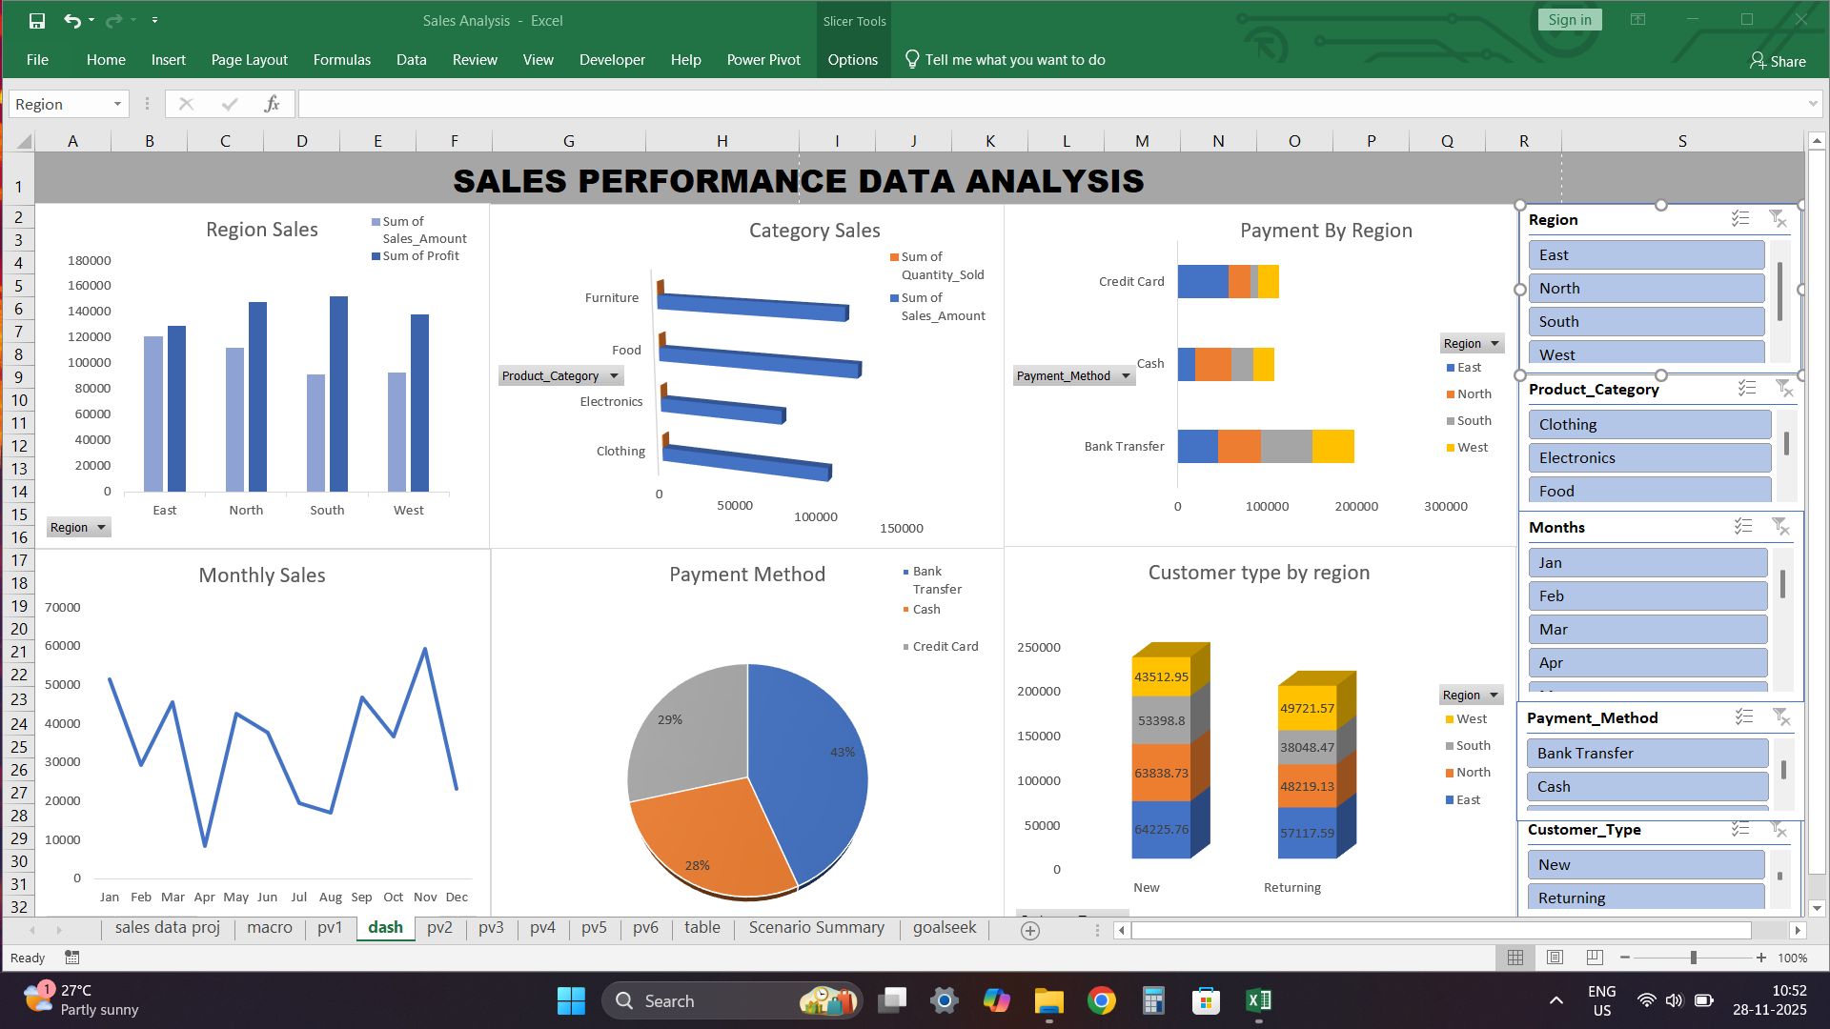
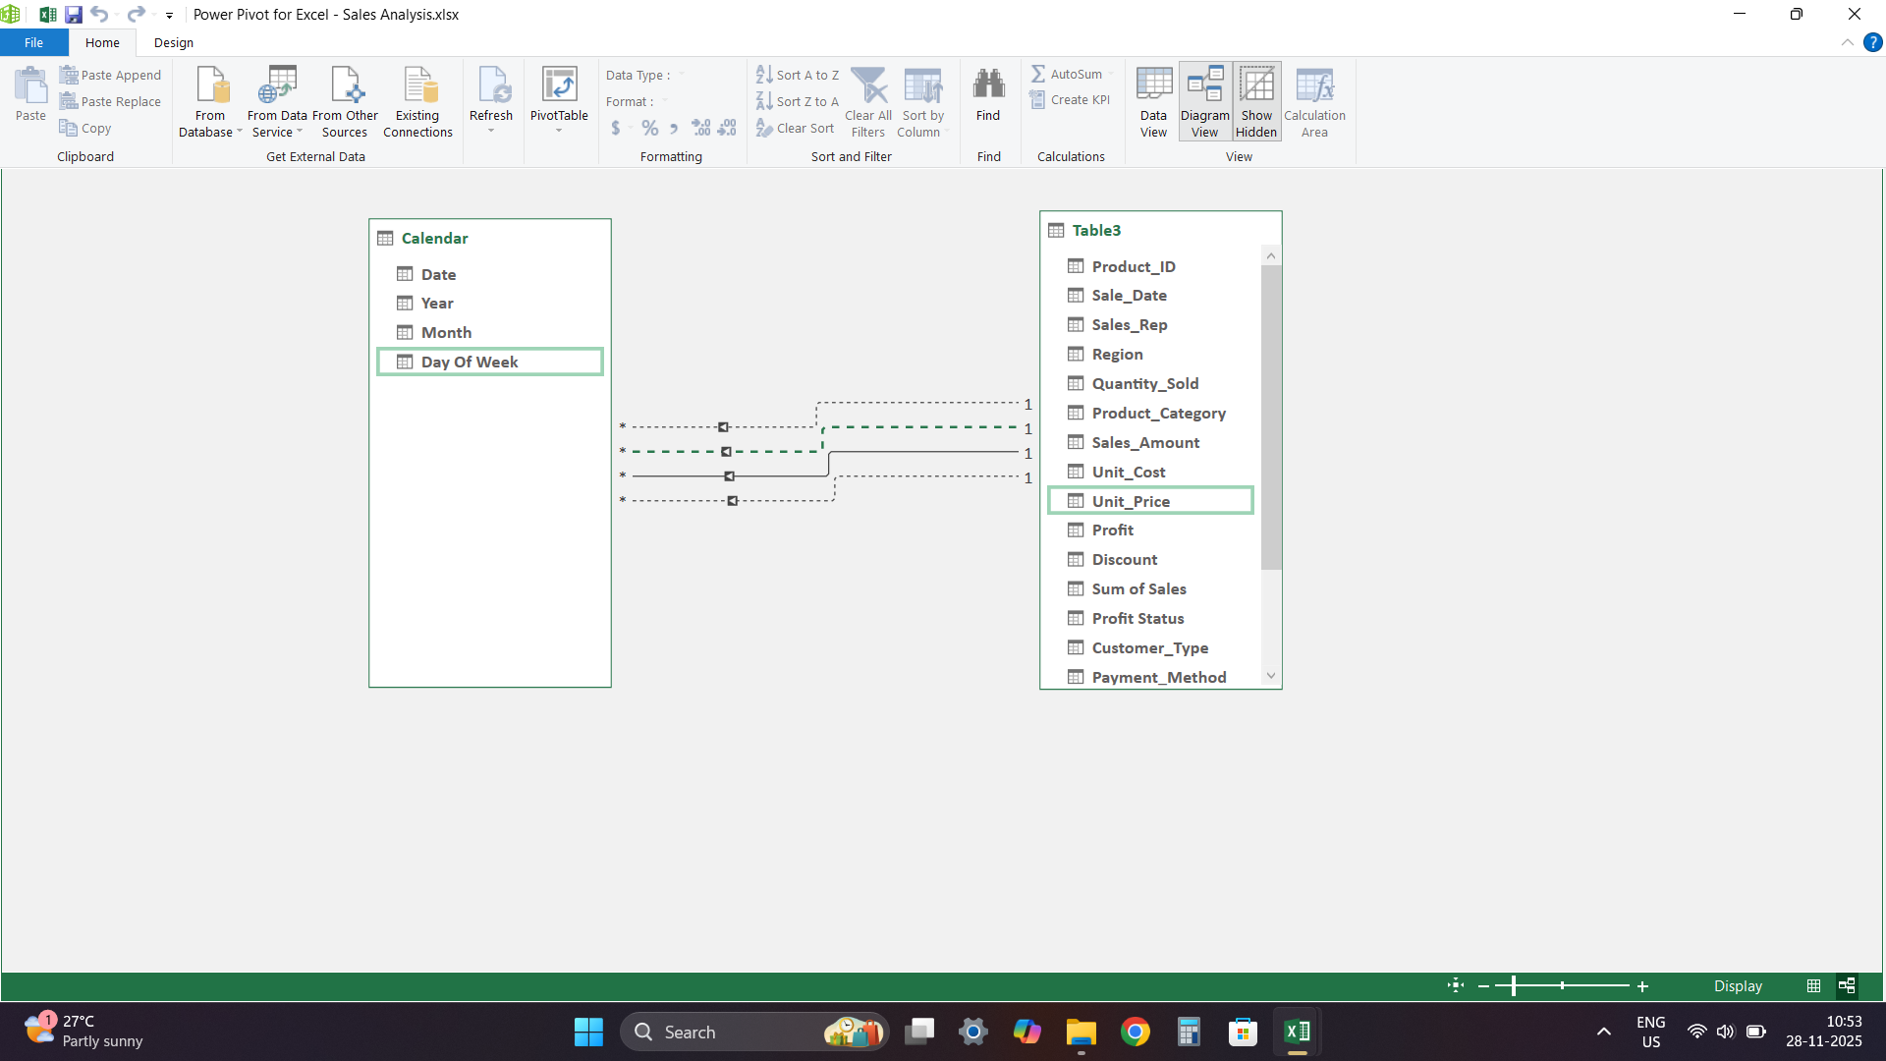
Analysis Performed
- Region-wise sales
- Category performance
- Sales rep comparison
- Customer type trends
- Payment and channel analysis

Slide 8
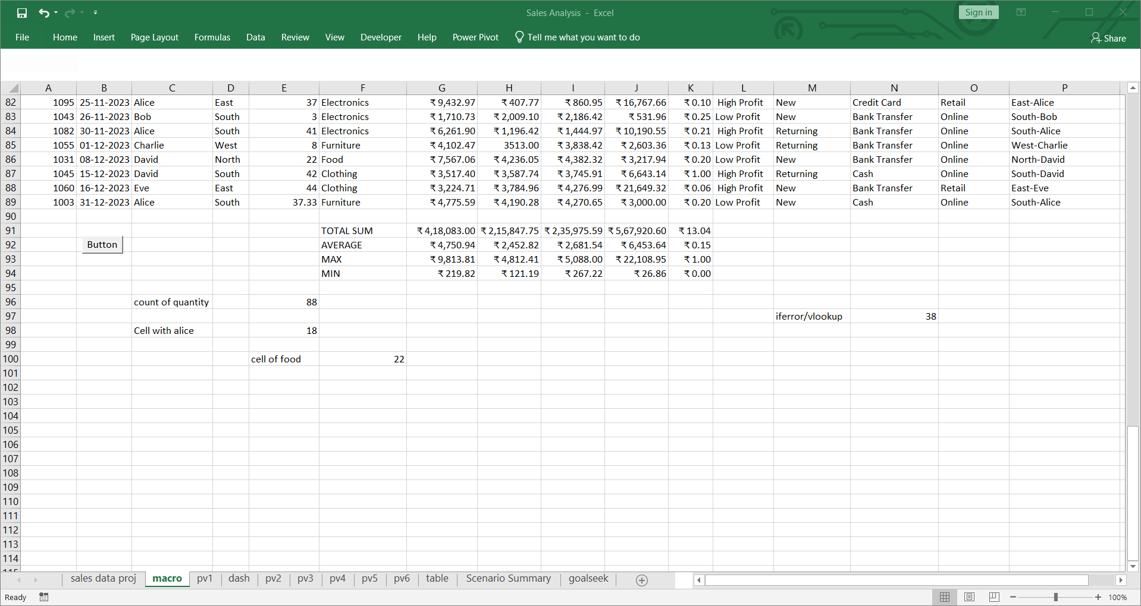
Excel Functions Used
SUM, COUNT, COUNTIFS, IF, IFERROR, VLOOKUP, AVERAGE, MAX, MIN, Pivot Tables, Goal Seek

Slide 9
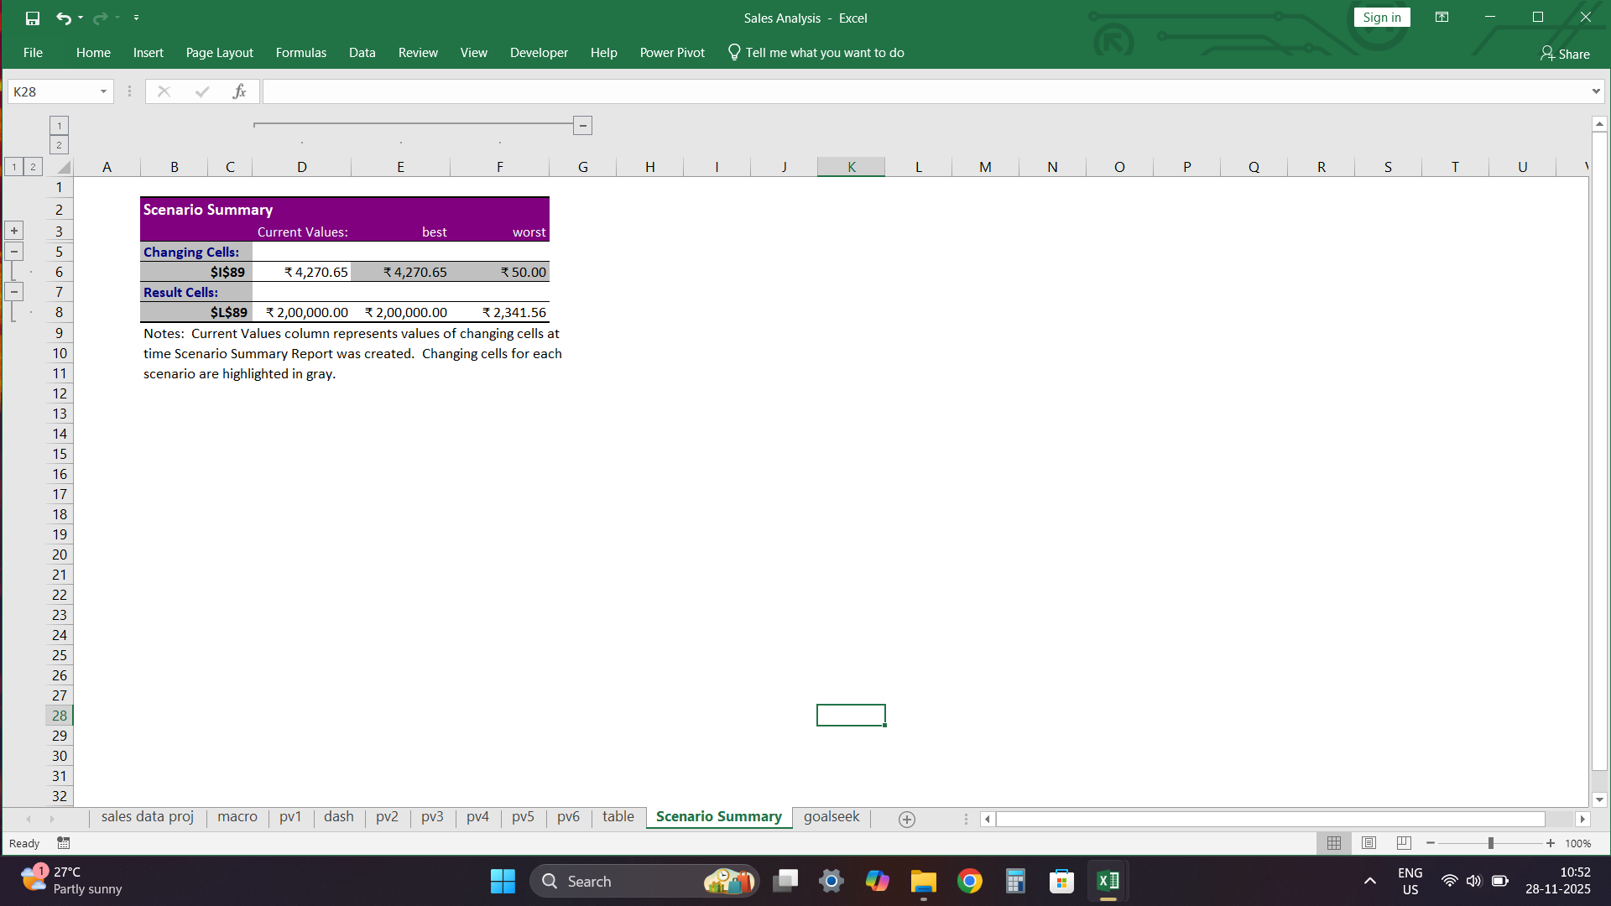
Insights & Findings
- Clothing & Furniture high profit
- North & South perform well
- Returning customers more profitable
- Online channel dominates

Slide 10
Conclusion
The analysis provides insights for better decision-making and improved sales strategies.

Slide 11
Future Scope
- Forecasting
- Automated dashboards
- Power BI integration
- Customer profiling

Slide 12
THANK YOU
viswan p n
d a batch

